Slide 1
Chapter 1 EXPRESS API
SUBMETED BY
KOUSTAV MUKHERJEE

Slide 2
CONTENT
INTRODUCTION OF EXPRESS API
PACKAGES WITH INSTALL COMMAND
CREATE JS FILES AND MAKE CONNECTION
USE POSTMAN FOR SEND REQUEST OR FILE
DIBUGGING

Slide 3
INTRODUCTION OF EXPRESS API
EXPRESS API is a web API that use the RESTful approach.
REST API is a API that are use resource-based interfaces.
In EXPRESS API that use web resources that’s is formatted in JSON or XML file that accessed via HTTP represented by URL (Path).

Slide 4
Install package and create application
Create a folder as a name like registration
Open the folder using VS Code editors
Open terminal of VS CODE Editors using this steps :- VS Code Manu > Terminal > New Terminal.
Go to Terminal and use npm command to create the application.

Slide 5
Install package and create application
Use npm command to initialized the application.
Command :- npm init
After that follow the step and give information like Author,Name,Description,Script etc.
After pressing ENTER key , it will ask you follow things and at last it will ask you “Is this OK? Write yes”.

Slide 6
Install package and create application
Install node module that are use to create application using npm install command
Express:- Express is a framework in express js
its provided various futures on web application.
For install express use npm i express

Slide 7
Install package and create application
Mongoose – mongoose provided database access for the local web site.
Its provided a schema that’s connect to mongo DB database .
For install mongoose use npm i mongoose

Slide 8
Install package and create application
Multer- it is use in node JS middleware multipart or form data which is primary used .
Its function that received the request and send response object when user create any type of request.
For install multer package we use the command npm i multer.

Slide 9
Install package and create application
Dotenv:- Dotenv is a file that’s used for environment variable from .env file
For install we use the command npm i dotenv.
Bcrypt:- Bcrypt is use for hash user password in the database .
Its store the plain text with encripted hash password method
For install we use npm i bcrypt.

Slide 10
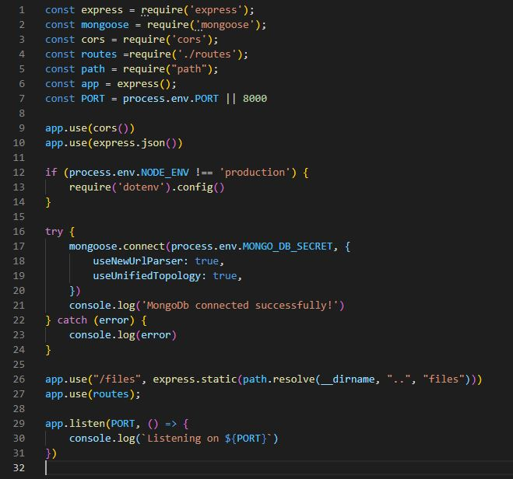
Create Server.js fle

Slide 11
Server.js file Explanations
It is the file that we use as a server file where we are make our connection.
In this file we are deploy our application in PORT 8000 .
In this file we are connect to our mongodb server with local .

Slide 12
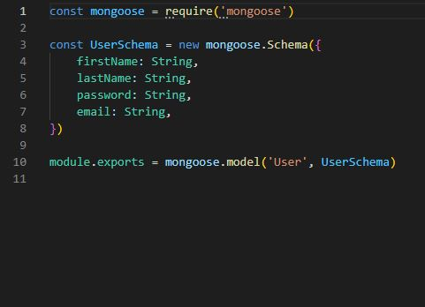
Create user.js file

Slide 13
User.js explanation
In the models folder we create User.js file .
In this file we are deploy mongoose that is use for create schema in mongodb server.
After that in this file we create our user schema like email firstName lastName.
After that we are export that other side .

Slide 14
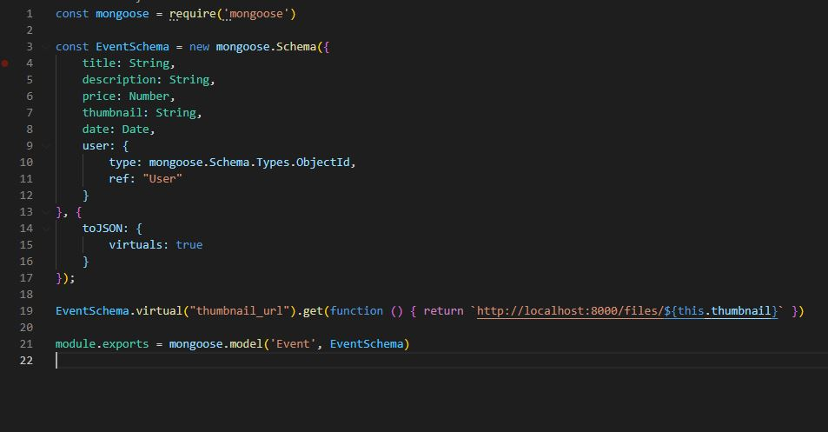
Create event.js

Slide 15
Event.js Explanation
In the Models folder another file name event.js
In this file we are deploy mongoose for create event schema
in the local we create local schema attributes like title ,date, thumbnail etc and all thous are take in strings .
After that we are export that make for event schma.

Slide 16
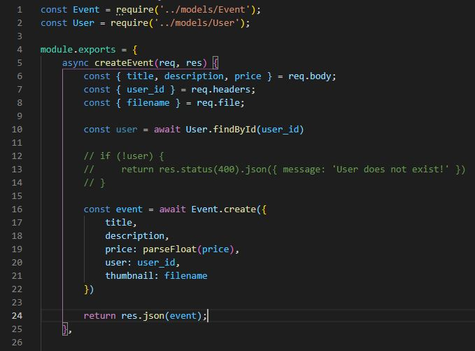
Create Eventcontroler.js file

Slide 17
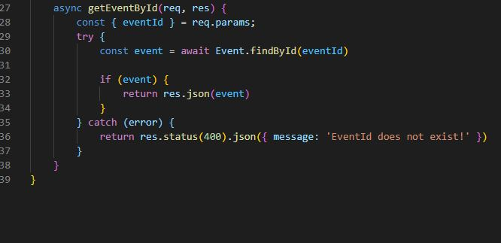
Create Eventcontroler.js file

Slide 18
Explanation of Eventcontroller.js
In the Eventcontroler.js file we are control or call event sub file.
First we create event to receive all the information form the request.
Then we apply findById() method to create user and check it using User_id.
If the user is exist then it create a event or if not exist then it show a massage user is not exist.

Slide 19
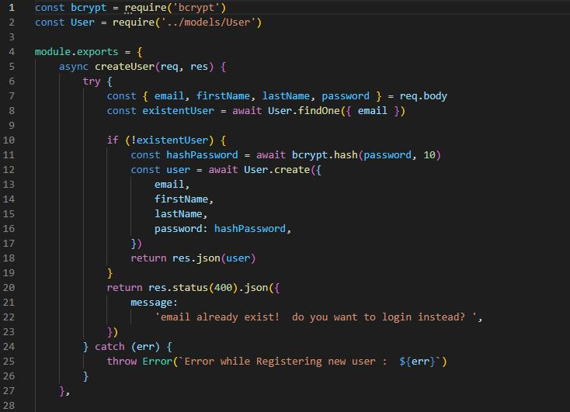
Create UserControler.js

Slide 20
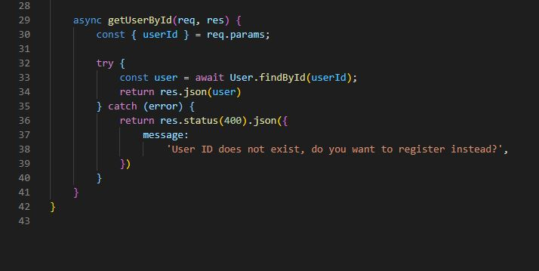
Create UserControler.js

Slide 21
Explanation of UserController.js
In the UserController.js file we are control or call the user sub file.
First we export the module and fetch that user is exist on the database or not if exist then show a massage user is exist and if not exist then create a new user using user schema.
After that we use getUserById()method and use the User_id and fetch the user is exist on database or not if exist it show the result and not then 400 error massage show.

Slide 22
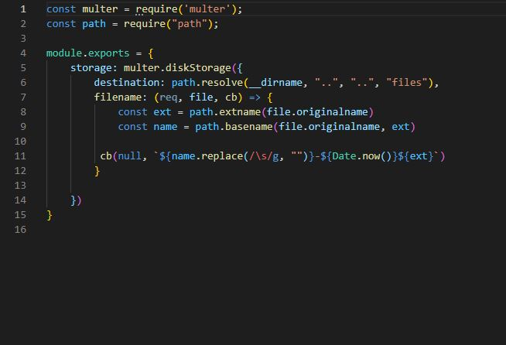
Create upload.js

Slide 23
Explanation of Upload.js
In the upload.js file we construct the file path
First we construct the path and then storage in local and make and url
After that its back to controller with file extension.
If that file had any rejection then its show error massage using controller file.

Slide 24
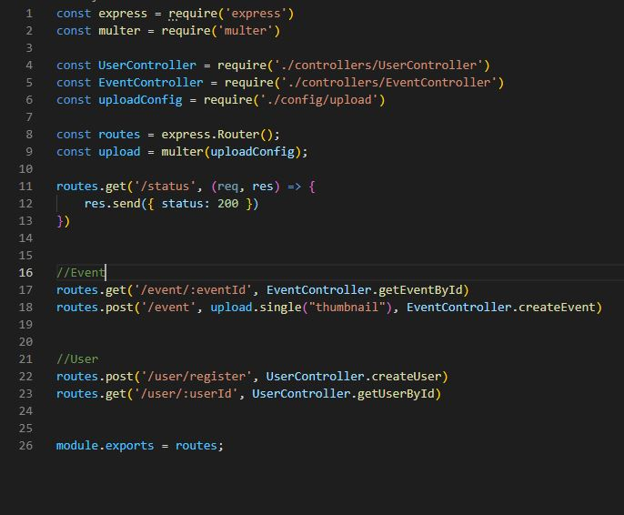
Create routes.js

Slide 25
Explanation of routes.js
In the routes.js file we are connected all the middleware that are routes of the main file .
And also create the user and event routes that we call through an API.

Slide 26
Use Postman to check request
Step 1 -> Install postman application
Setp 2-> open postman application and sign in
Step 3 -> go to create a new collection(+) and create a request
Step 4 -> setup ulr and method (post,get etc)
Step 5 -> go to body and select and formdata for form or row like JSON format and fill data
After complite data fill send .

Slide 27
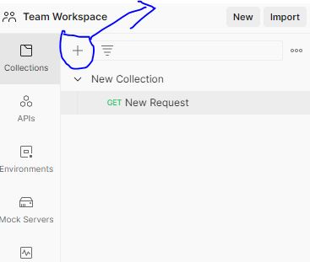
Process step of postman

Slide 28
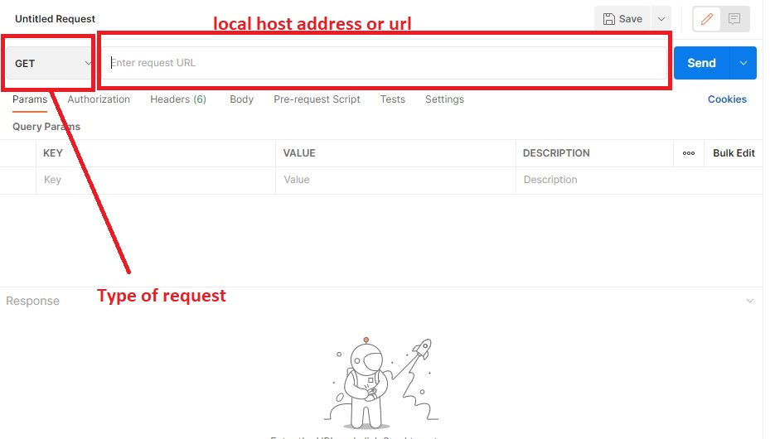
Process step of postman

Slide 29
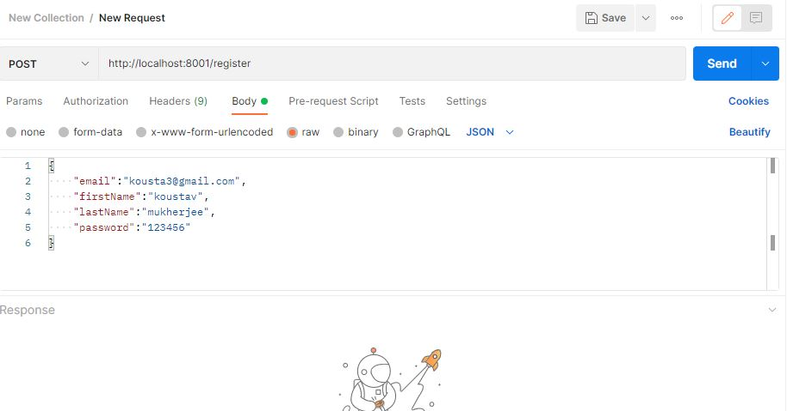
Process step of postman using register

Slide 30
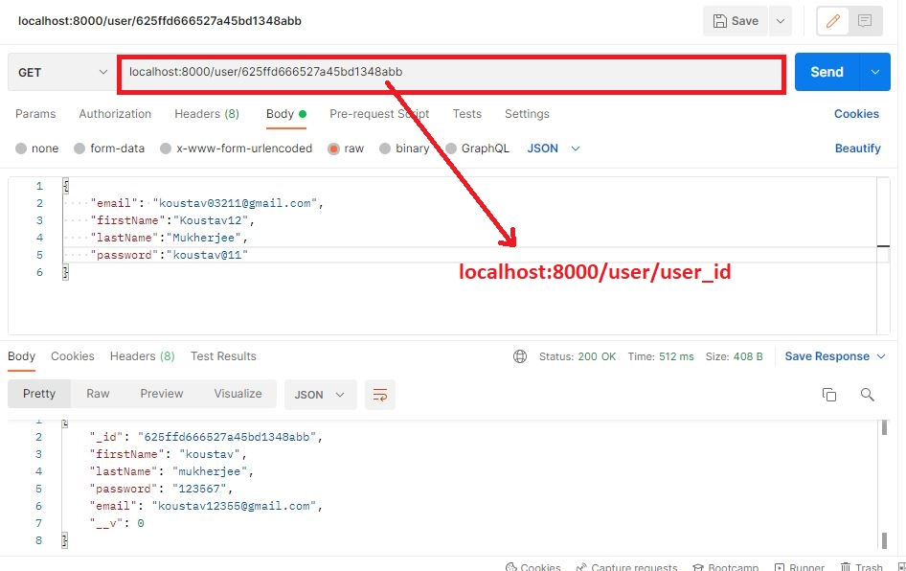
Process step to fetch data using get method by user_id

Slide 31
Create an event using postman
Step 1-> select method POST and add url
Step 2-> Go to body and select form-data and fill-up all data like title, date, description it is fill as text and select and filled like thumbnail change it to text to file from the postman hidden button and after that select the file.
Step 3 -> go to send button to send the request.
Step 4 -> change the request GET and then search a event by event _ id .

Slide 32
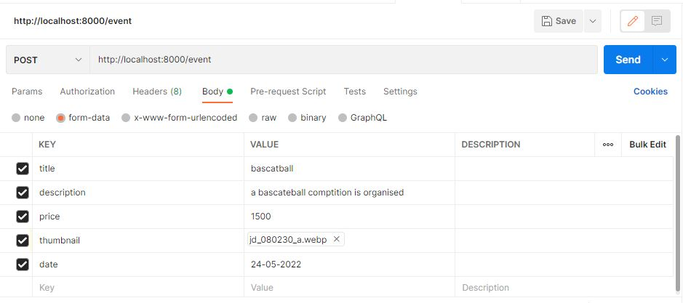
Process step of postman using event

Slide 33
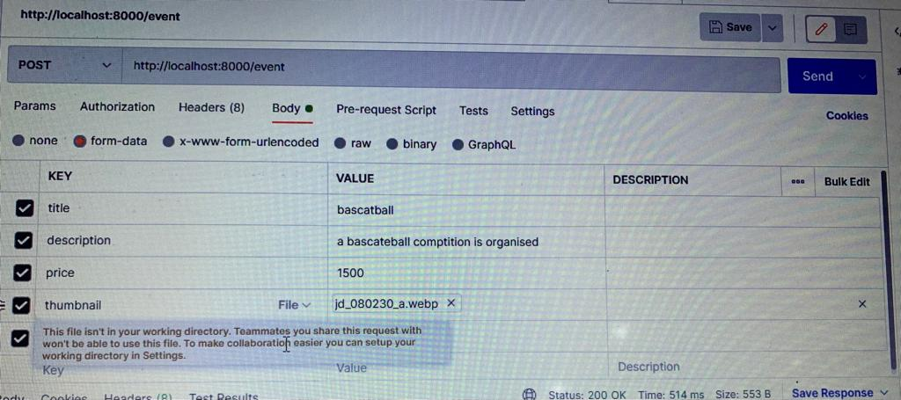
Process step of postman using event (change hidden text to file add the file in thumbnail)

Slide 34
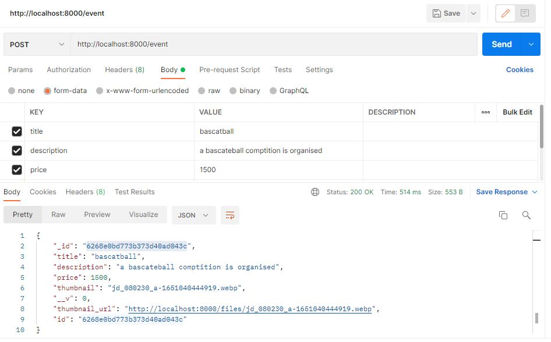
Process step of postman using event(click on send button and see result

Slide 35
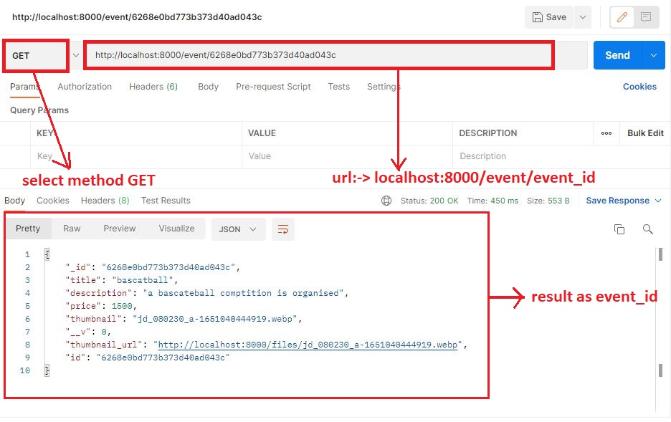
Process step to fetch data using get method by event_id

Slide 36
Process step of Insomnia
Step 1 -> Install postman application
Step 2-> open postman application and sign in
Step 3 -> go to create a new collection(+) and create a request
Step 4 -> select method and add and name
Step 5 -> setup url and method (post, get etc)
Step 6 -> go to body and select and form data for form or row like JSON format and fill data
After complete data fill send .

Slide 37
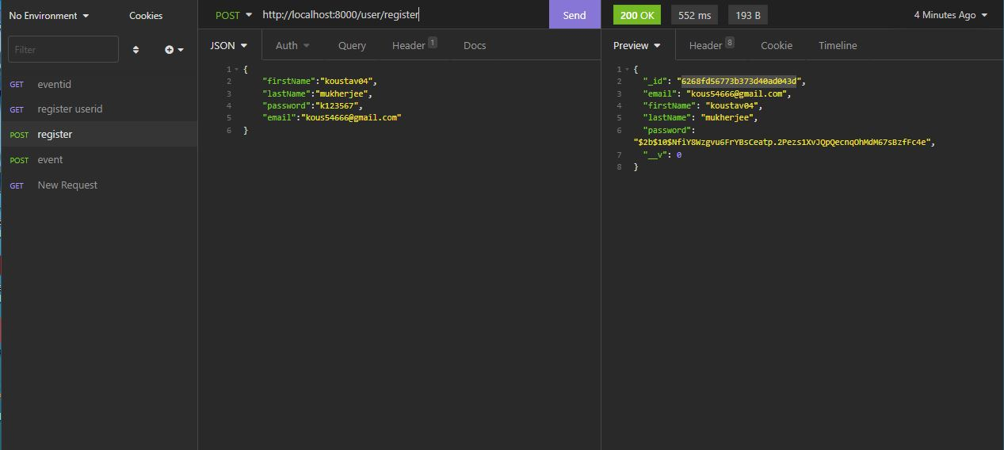
Process step of Insomnia for register an user

Slide 38
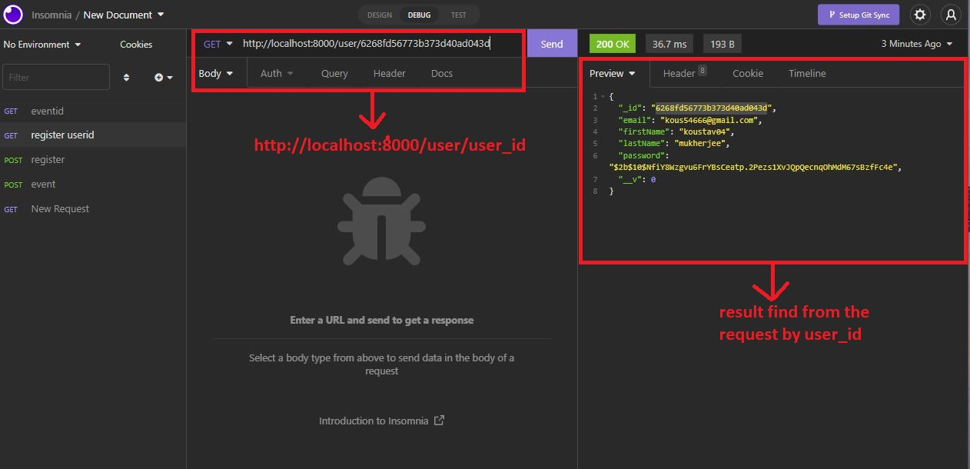
Process step to fetch data using get method by user_id

Slide 39
Create an event using insomnia
Step 1-> Go to + button and select a new request
Step 2 -> select Post method and give an name
Step 3-> Go to body and select multi – data part and fill-up all data like title, date, description it is fill as text and select and filled like thumbnail change it to text to file from the insomnia select button and after that select the file.
Step 4 -> go to send button to send the request.
Step 5-> change the request GET and then search a event by event _ id .

Slide 40
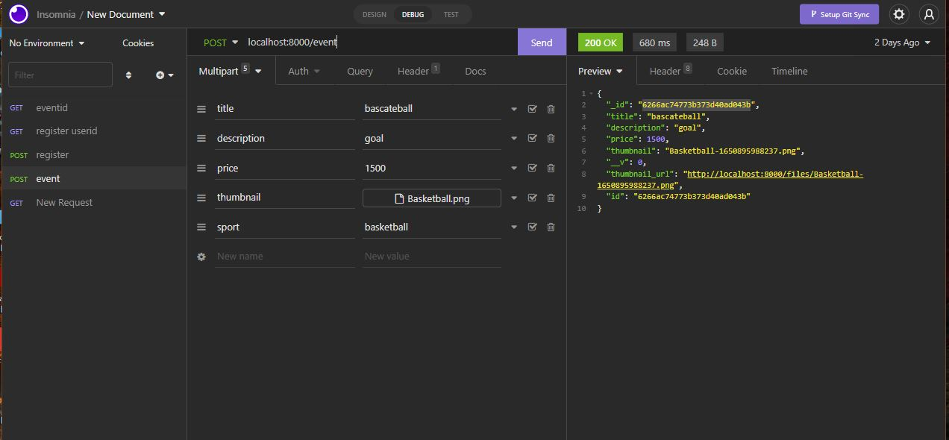
Process step of Insomnia for create an event

Slide 41
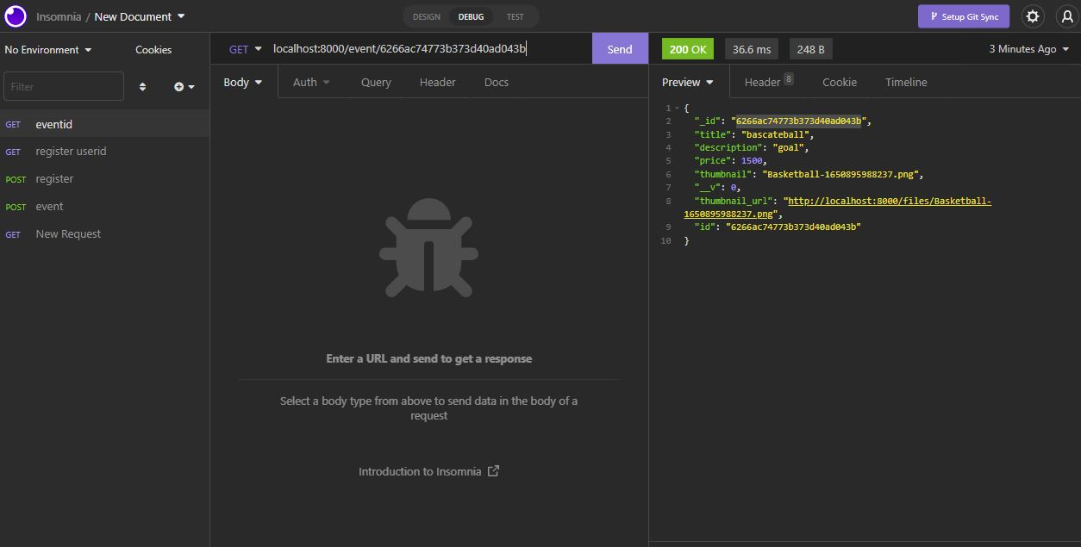
Process step to fetch data using get method by event_id

Slide 42
DEBUGGING
The Visual Studio Code editor has all the tools to debug Node.js applications effectively. Its built-in debugger can debug any application that targets the Node.js runtime, even if the source code for the application is a language that transpiles to JavaScript, such as TypeScript.
The easiest way to start a debugging session in Visual Studio Code is to open a file in the editor, click the Run View icon in the Activity Bar (or press Ctrl+Shift+D on your keyboard), followed by the Run and Debug button at the top left corner of the application.

Slide 43
DEBUGGING
The Visual Studio Code debugger will try to auto-detect the debug environment for your project, but if this fails, you will be prompted to select the appropriate environment; in this case, select Node.js.
After selecting an environment, the project launches and the debugger attaches to the process. You can see the output of your project in the DEBUG CONSOLE, and the debug toolbar appears at the top of the screen to step through the code, pause the script, or end the session. On the left-hand side of the editor, there are five panes titled VARIABLES, WATCH, CALL STACK, LOADED SCRIPTS, and BREAKPOINTS.

Slide 44
Thank You

